Slide 1
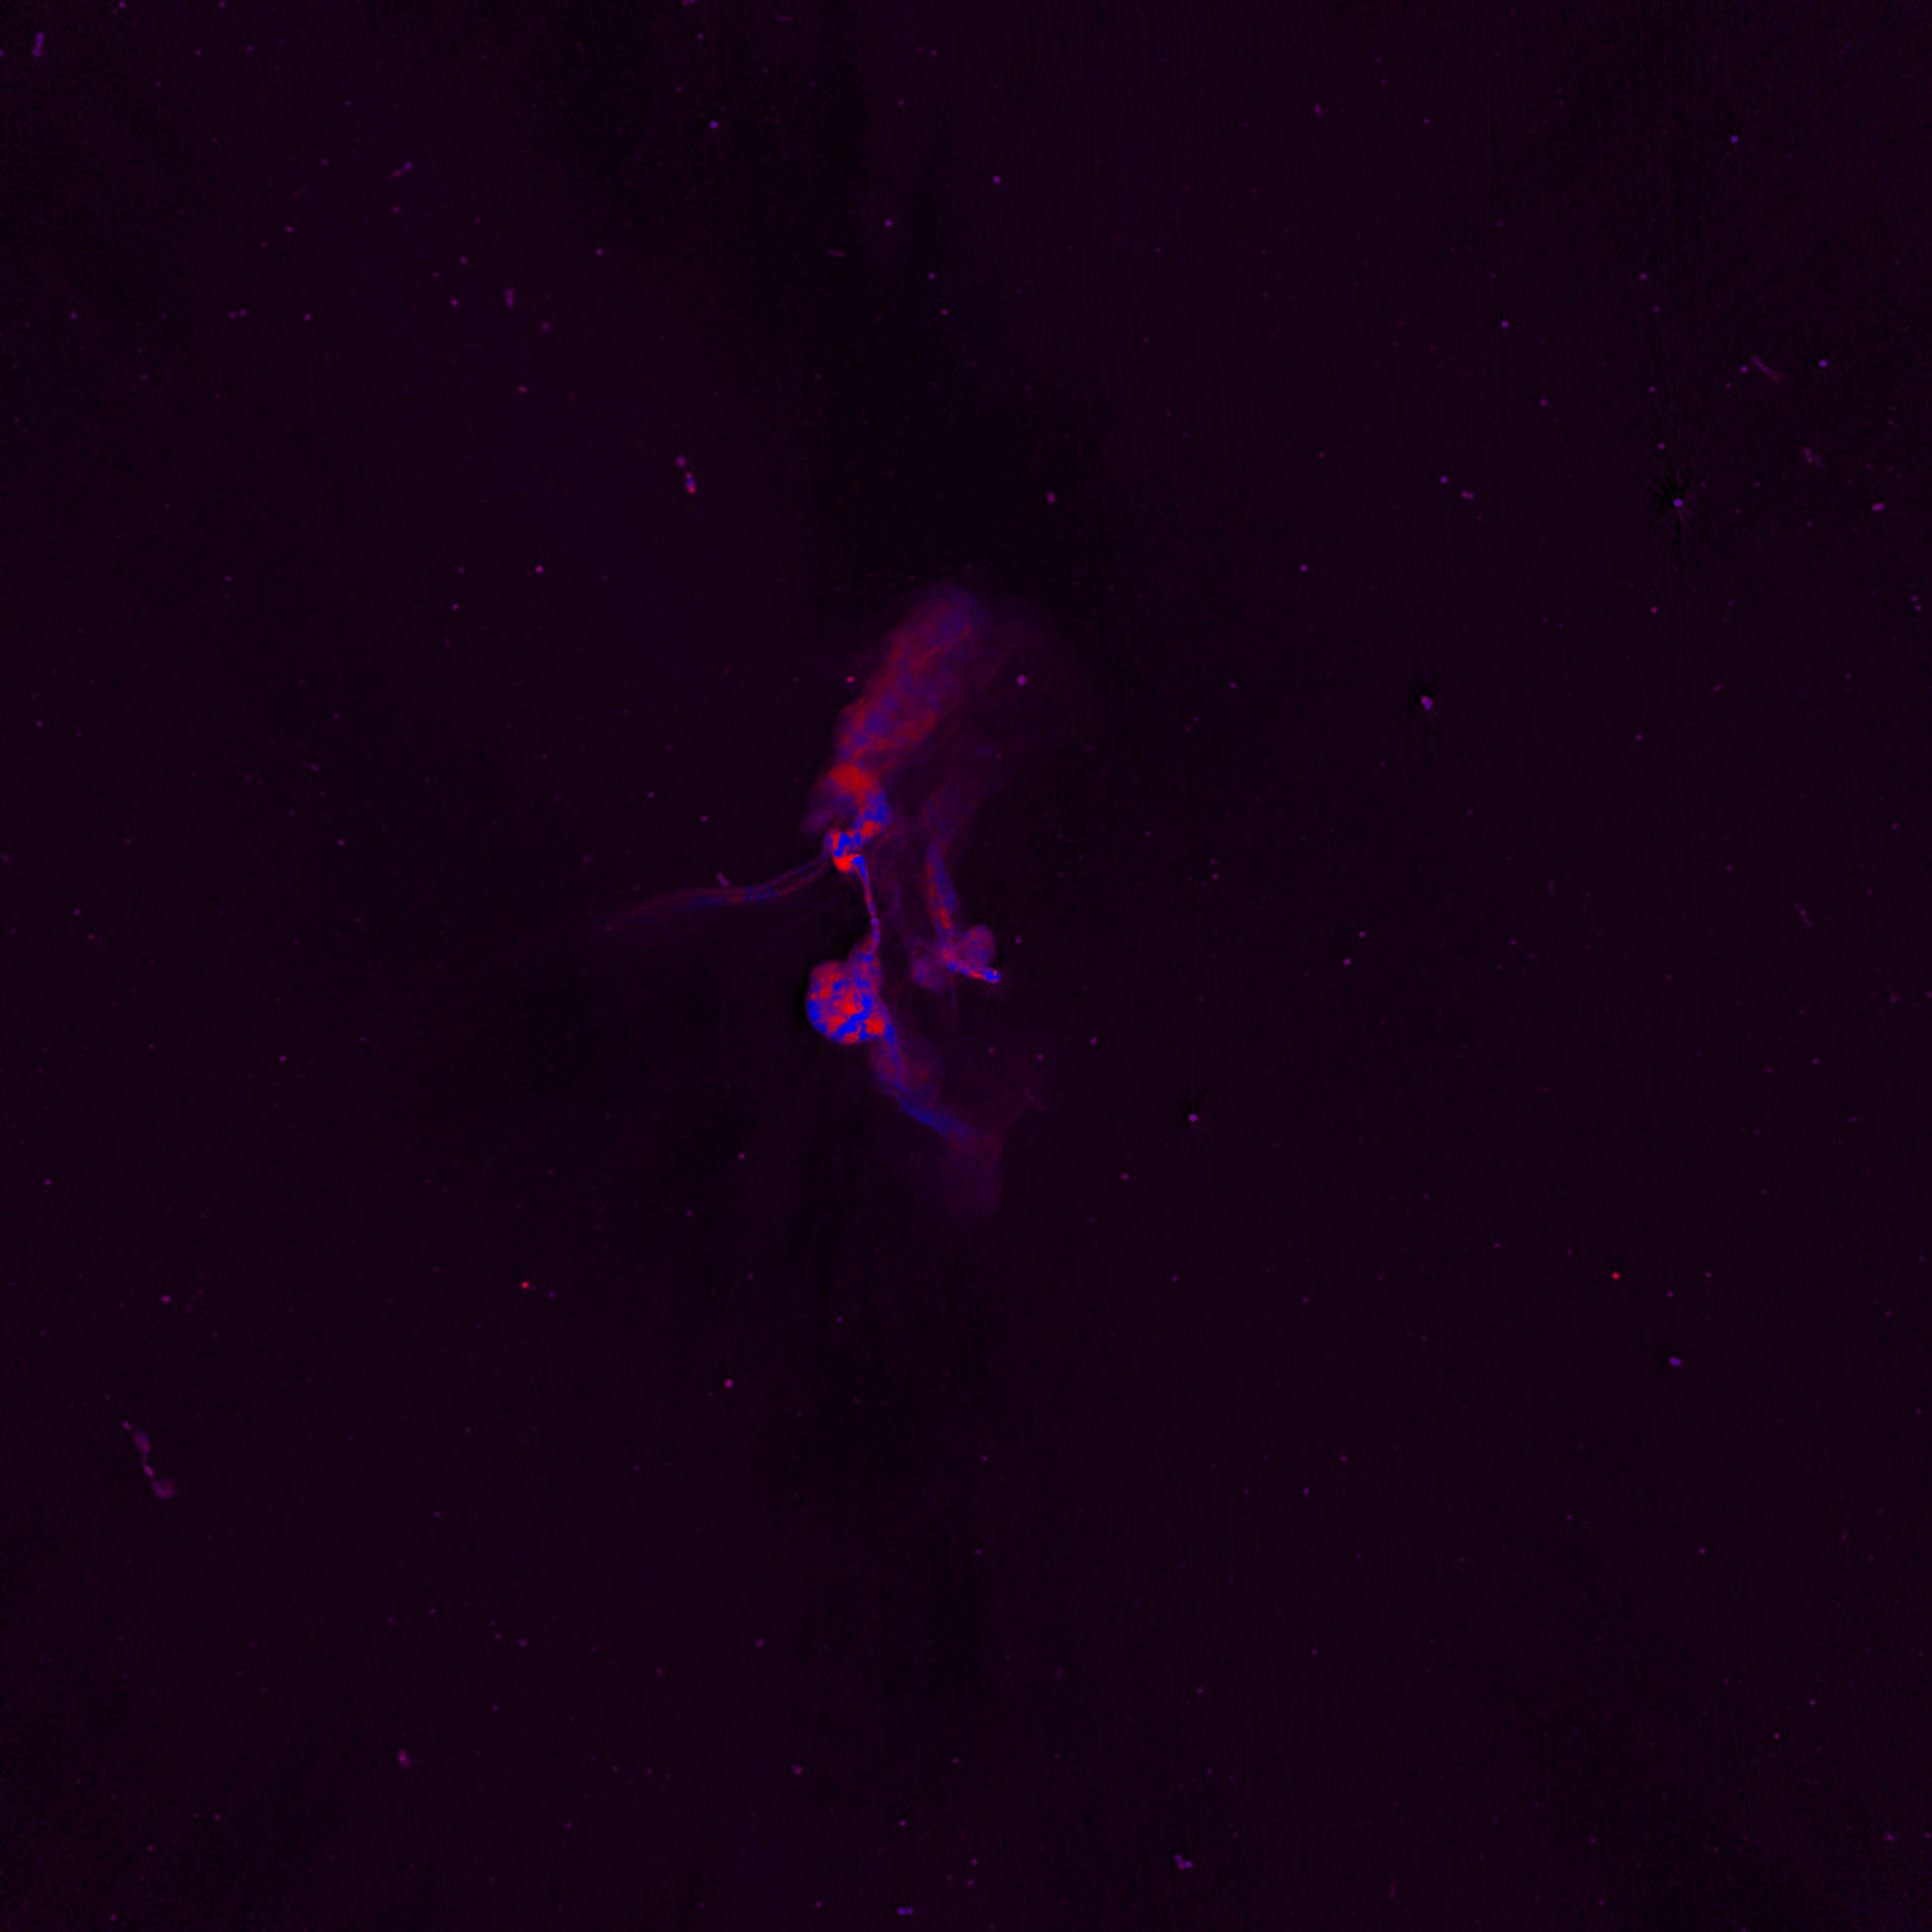
BRP Meerkat Progress Journal
This Journal contains my whole workflow, notes,…

Slide 2
Step 1: Literature (1)
I read following things:
Fractional polarization as a probe of magnetic fields in the intra-cluster medium
Diffuse Radio Emission from Galaxy Clusters
The MeerKAT Galaxy Cluster Legacy Survey
Magnetic Fields and Faraday Rotation in Clusters of Galaxies
Optical polarization of AGNs, Damien Hutsemékers, (University of Liège, Belgium)
Non-thermal processes in cosmological simulations
Simulations of the Structure of Magnetic Fields in Galaxy Clusters - Forrest Glines https://www.youtube.com/watch?v=lSPh3fEzK6Q
Magnetic Fields in Galaxy Clusters: A Radio Astronomer's Perspective - Chris Riseley https://www.youtube.com/watch?v=K5Wqk3OUE9A&t=232s
Dr. George Heald: Revealing cosmic magnetism with the Square Kilometre Array and its pathfinders https://www.youtube.com/watch?v=2rv4uUDJsIE
The 1.28 GHz MeerKAT DEEP2 Image

Slide 3
Step 1: Literature (2)
Some notes:
Due to the selection, this sub-sample is strongly biased towards clusters with radio halos and relics.
“In Stokes I, we cleaned to a depth of ∼ 80 µJy beam−1, using up to 500,000 components. Stokes Q and U were CLEANed to a depth of ∼ 30 µJy beam−1 with up to 50,000 components. Off-source noise values in images which were not dynamic range limited were ∼3 µJy beam−1.” → does this mean I should ignore sources below this treshhold?
“We used the same 5% frequency bins and the total bandwidth used by the Stokes I imaging, which allows the recovery of RMs up to ± 100 rad m−2 at full sensitivity, with decreasing sensitivity beyond this range.”
There is already a source catalogue available which I can use
Full literature study notes can be found in “Literatuurstudie.docx”

Slide 4
Step 2: Investigate Erik’s method and the problems he faced with VLA (1)
I downloaded Erik’s Git and read his paper.
I discovered that he had to do a lot of calibrating himself which I shouldn’t have to deal with myself → already done by Meerkat team
Erik had data with far lower SNR than Meerkat → should be able to find more sources

Slide 5
Step 3: Downloading and inspecting data (1)
I quickly saw that the 15arcsec version has lower angular resolution → probably a convoluted version of the Farcsec version
Many sources >500 are visible in the I channel
Less sources ~30 are visible on the Q channel, not bad!
There are negative values in the I channel, around artifacts

Slide 6
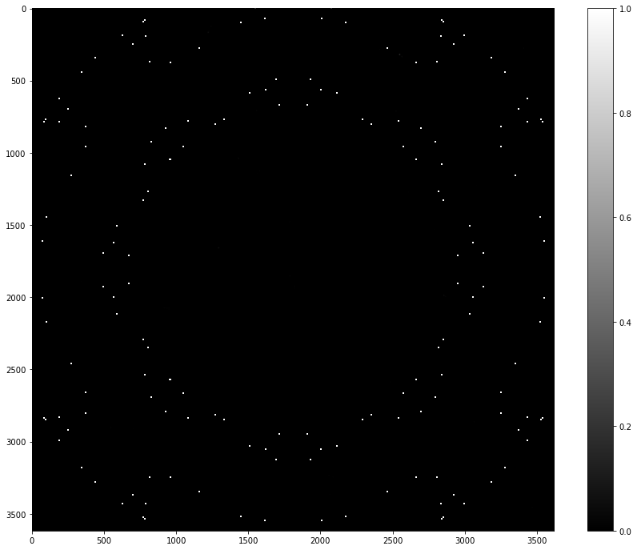
Step 3: Downloading and inspecting data (2)
On the I and Q cubes, a perfect ring is present of NaN pixels, spanning the whole image.
This is not normal. This is visible on more than one image and the circle changes radius depending on the frequency
“To account for the unreliability of primary beam corrections far from the pointing centre, pixels are blanked as for the 5pln cubes discussed above.”
Should we only look at sources within this circle then?
“Derived brightnesses, and especially
spectral indices, are therefore not reliable beyond a radius of 36′.”
I datacube averaged over all frequencies, all rings can be seen:

Slide 7
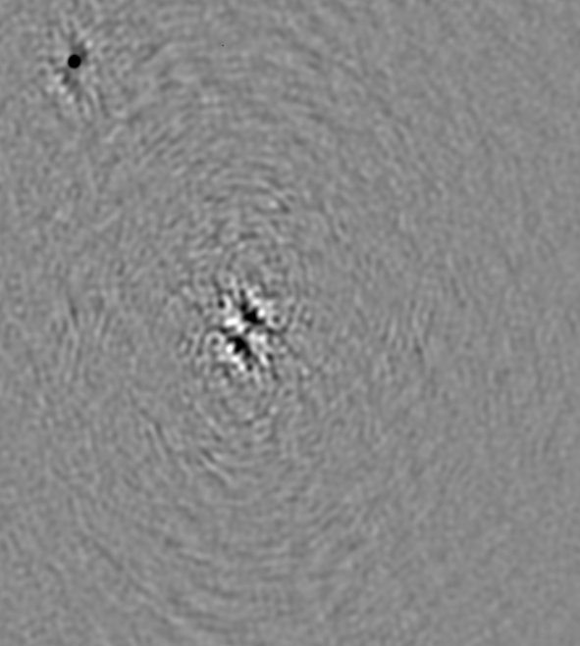
Step 3: Downloading and inspecting data (3)
On the Q channel, some sources are darker than background while others are lighter than the background. This is completely normal!
The artifacts around bright sources become dominant in the Q channel. On the image below, upper left is normal source, middle is artifact.\
“Fields with very strong sources (I > few 100s mJy beam−1) are typically limited by residual artefacts from the brighter sources.”

Slide 8
Step 3: Downloading and inspecting data (4)
A match was searched between the available Meerkat and Eriks VLA polarization data
Three objects were found to overlap:
Abell_85 = G115.16-72.09 = MATCH has 18 Eriksources
Abell_209 = G159.85-73.47 = MATCH has 5 Eriksources, only I,U,V, Q is missing
Abell 133 = G149.55-84.16 = MATCH has 1 Eriksource
The available Full polarization objects, their designations and matches with Erik are put in Available_PolClusters.txt

Slide 9
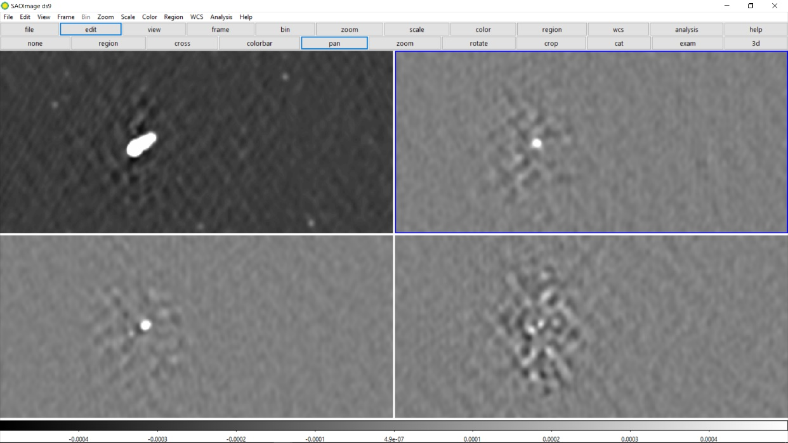
Step 3: Downloading and inspecting data (5)
We look at Abell 85 in I, Q, V and U:
We see that there are about 20 sources of polarization findable in the Q-channel.
If we take a look at one such source, we see that there is also quite some polarization visible in the U channel and some artifacts in V, but no source in V as expected. This is at the longest wavelength. All polarization channels are scaled the same from -0.0005 to 0.0005 Jy/beam. I channel is scaled differently and logarithmically.
I
Q
We also see sources fluctuate quite strongly in both Q and U as we scroll through frequencies → PROMISING!
U
V

Slide 10
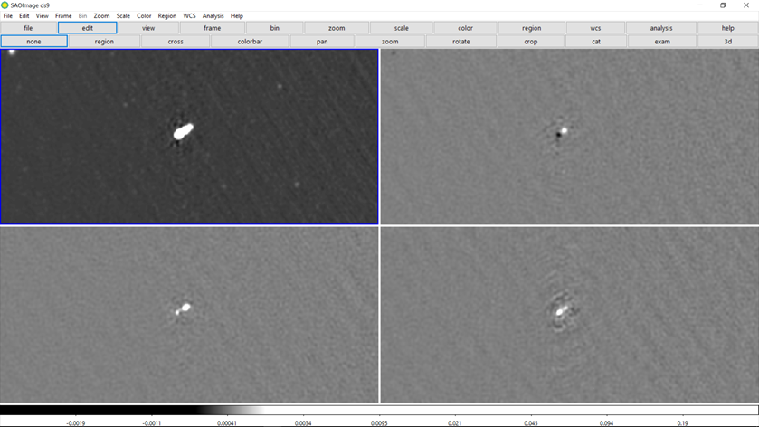
Step 3: Downloading and inspecting data (6)
However, as we decrease the wavelength, a source becomes visible in V also. At image 8-9, we get a negative source in V, at 10 none and at 11-12 a positive source. How is this possible? Below an image with all frames at the 12th shortest wavelength:
I
Q
U
V
This is very strange. Moreover, the amount of circular polarization is in the same order as the linear polarization channels. I find this suspicious, as AGNs generally are NOT circularly polarized. It is checked if this is the same for other sources.

Slide 11
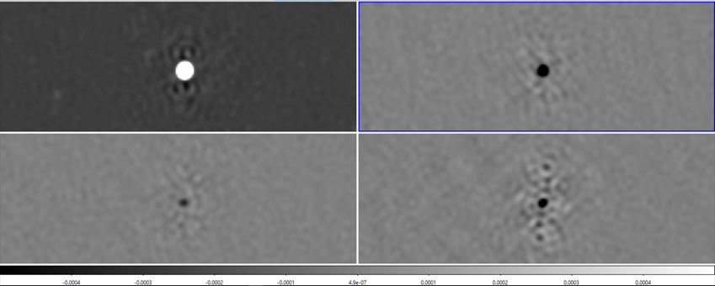
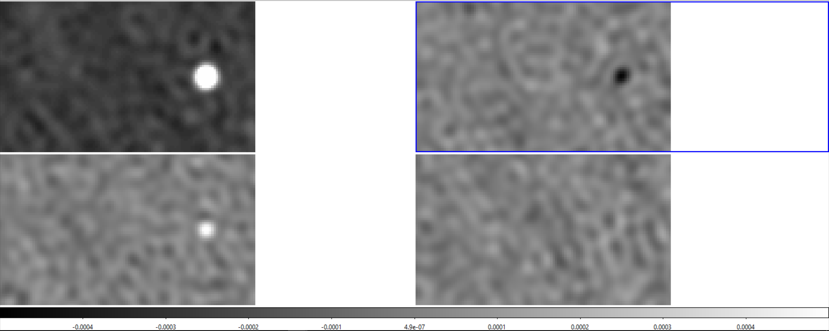
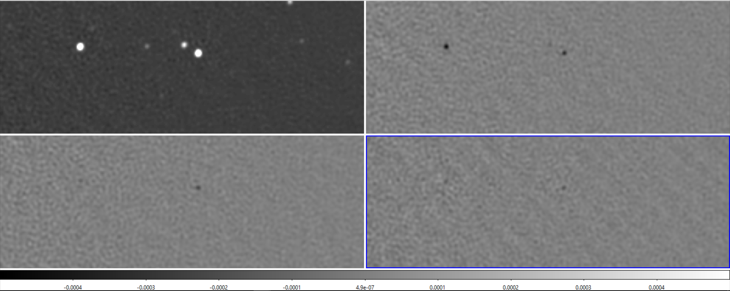
Step 3: Downloading and inspecting data (7)
Also leakage into V channel for other sources?
This other bright source has the same thing going on. But what about dimmer sources?
I
Q
U
V
The dimmer point sources have no circular component, it looks as if circular polarization only is visible when intensity is very large at certain beams → I suspect leakage. Linear polarization could be result of leakage instead of sources themselves.
2 dimmer sources, same IQUV positions in frame:
Erik also a bit concerned but Reinout says:
Op zich niet heel vreemd dat de Stokes V nog best veel signaal laat zien (VLA heeft daar ook wel last van, afhankelijk waar je in het FoV zit). Leakage zal gelukkig geen “oscillerende” Q en U veroorzaken.

Slide 12
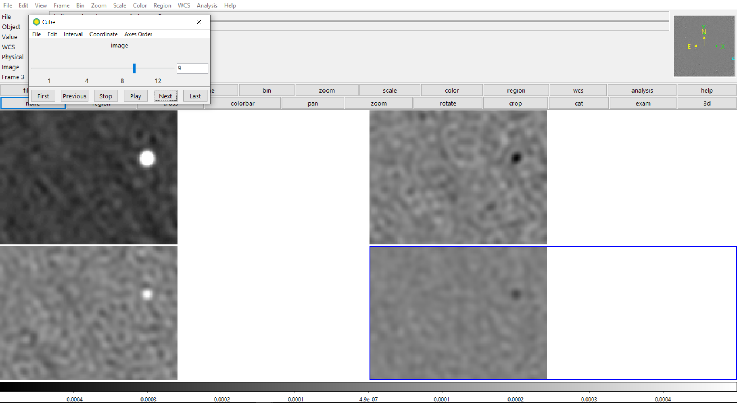
Step 3: Downloading and inspecting data (8)
About dimmer sources and Q leakage:
Note: at wavelength image 9, there seems to be a signal in V for both dimmer sources, all other wavelengths show nothing.
These same dim sources generally mostly show polarization at short wavelengths, not at longer ones. I found a dimmer source that remains polarized at all wavelengths though.
Reason?: “Note that polarisation leakage affects the upper half of the band, with the residual polarisation leakage increasing with distance from the field centre within the half-power region of the beam (de Villiers & Cotton, priv. comm.; de Villiers et al. 2021). The instrumental polarisation may reach up to 10% in the upper part of the band, while it is typically less than 2% at the lower frequencies. Users should evaluate how the leakage affects their particular science case.”
So, sources with polarization at shorter wavelengths only could indicate that they are solely due to leakage. However, this could also be a result from depolarization at longer wavelengths → how to discern?

Slide 13
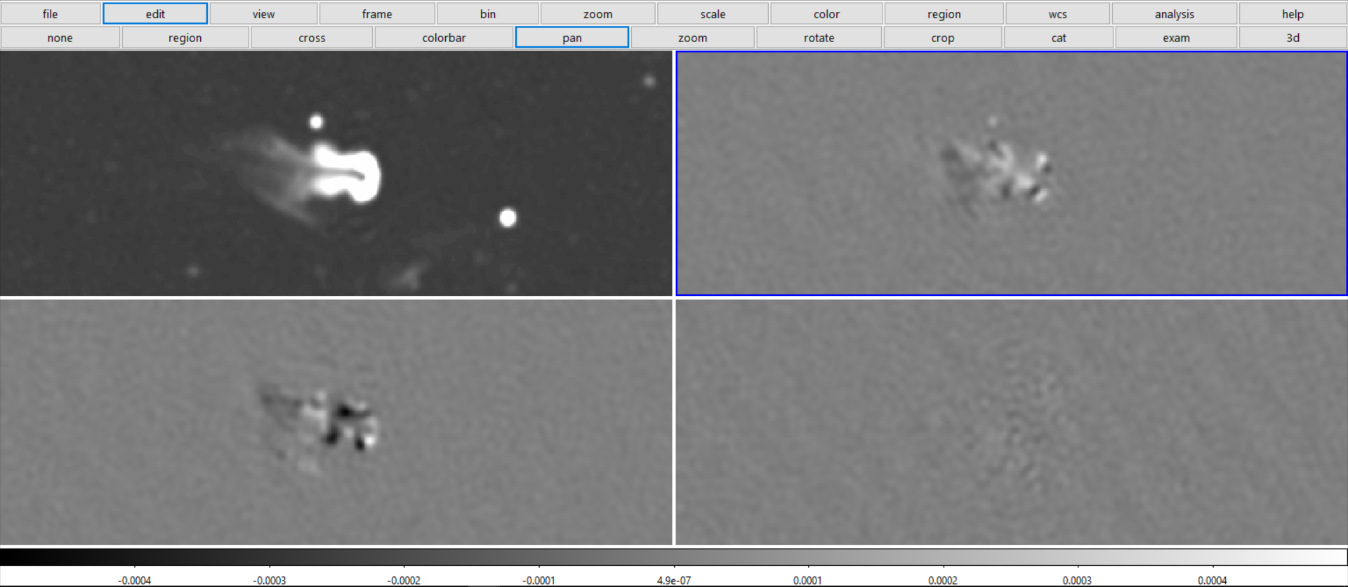
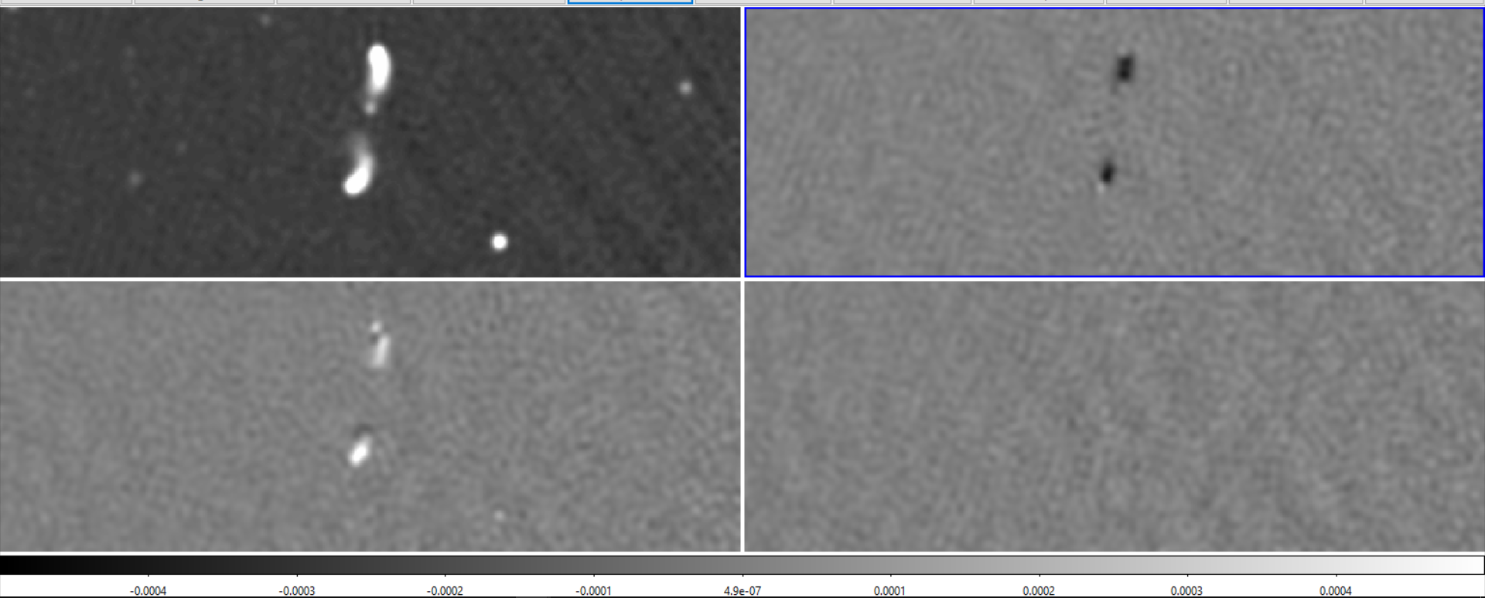
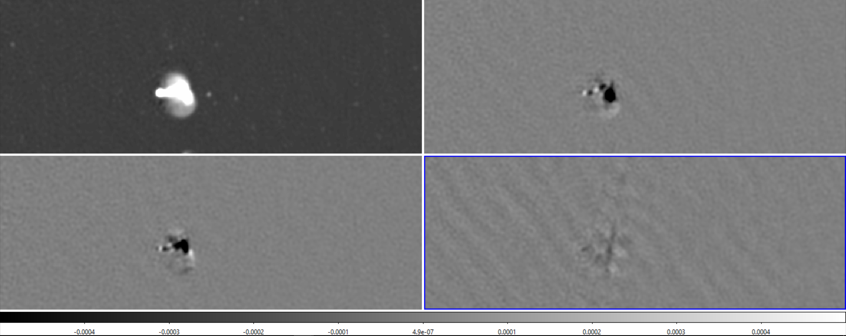
Step 3: Downloading and inspecting data (9)
What about resolved sources of polarization?
For all these diffuse resolved sources, we don’t see the same pattern. We see linear but no circular polarization. For these resolved sources, no circular polarization is seen over the whole spectrum range (apart from some very weak diffuse structures).

Slide 14
Step 3: Downloading and inspecting data (9)
Leakage in V is to be expected according to Meerkat MGCLS paper:
I. Survey Overview and Highlights: Due to the lack of internal polarisation calibration, the Stokes V images are not sufficient to detect weakly circular polarised sources, but can work as an overall check of the quality of the calibration.

Slide 15
Literature research on Meerkat specific data analysis process
Sources more elaborate than DR1 paper were too hard to understand and probably not worth my time. I can use the notes made in DR1 to use the data. I learned some things however, which explained my observations of problems with the data. These are added in red to the previous slides.

Slide 16
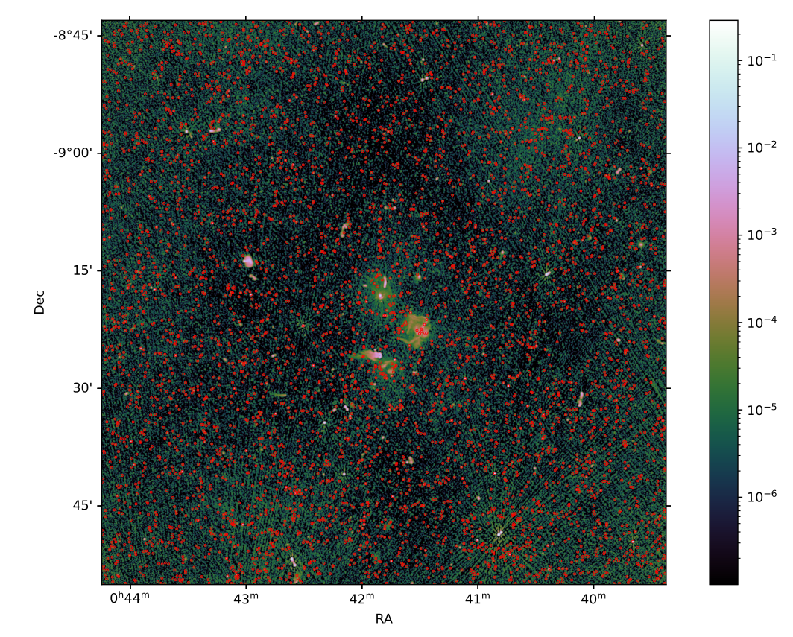
Selecting AGNs and applying photometry (1)
The first step in selecting AGNs is plotting the compact source catalog (CSC) of Meerkat and visually inspecting it to see if all these sources can be candidates to study.
The first attempt shows a lot of sources, all >5 sigma above background noise. The brightest sources are not selected and so are the artifacts for a radius around the brightest sources

Slide 17
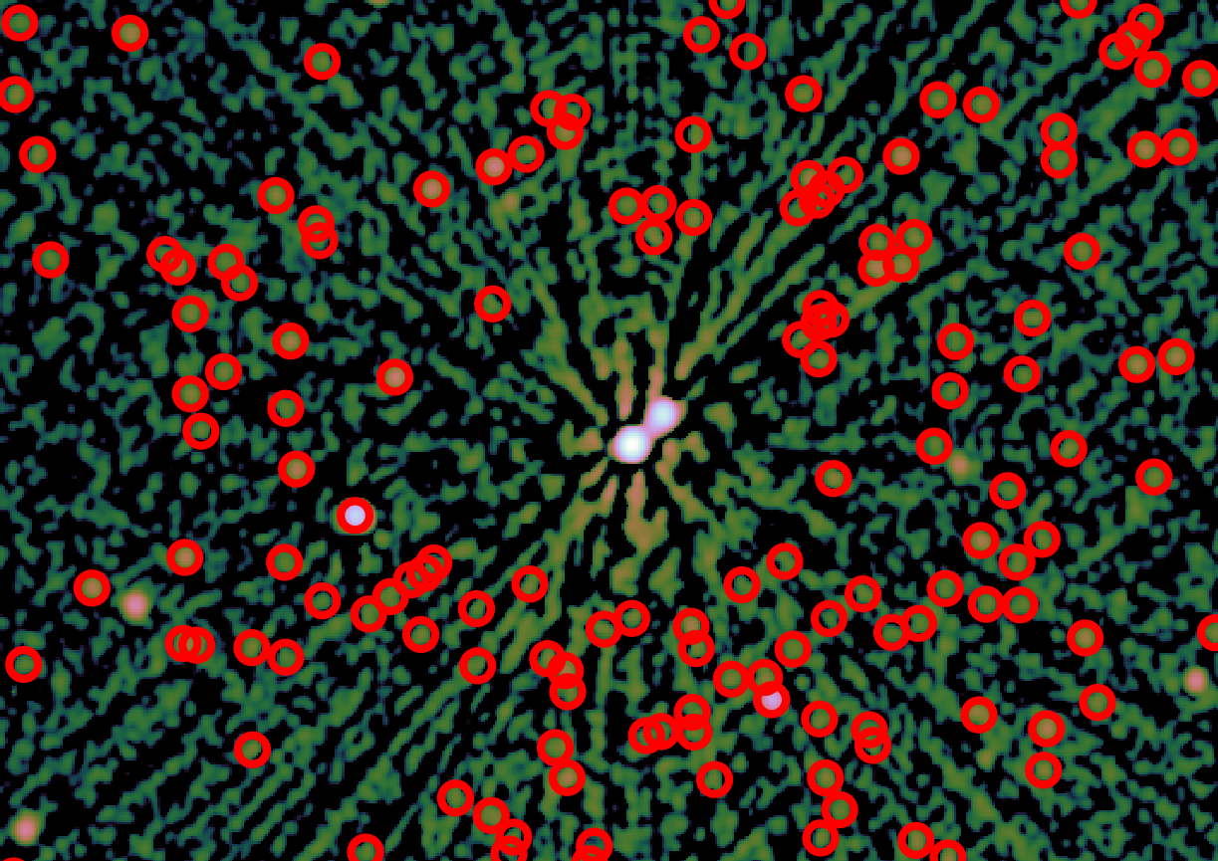
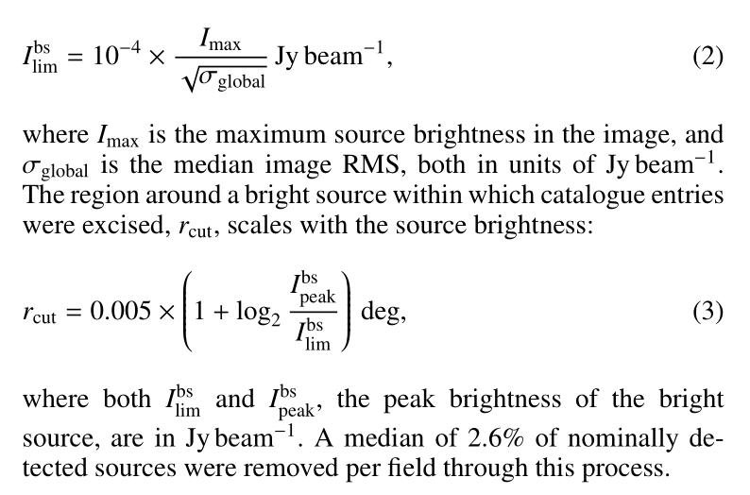
Selecting AGNs and applying photometry (2)
As can be seen on the right, bright sources don’t get detected and have a region around them without detections. The brightness requirement and the radius are defined as follows:

Slide 18
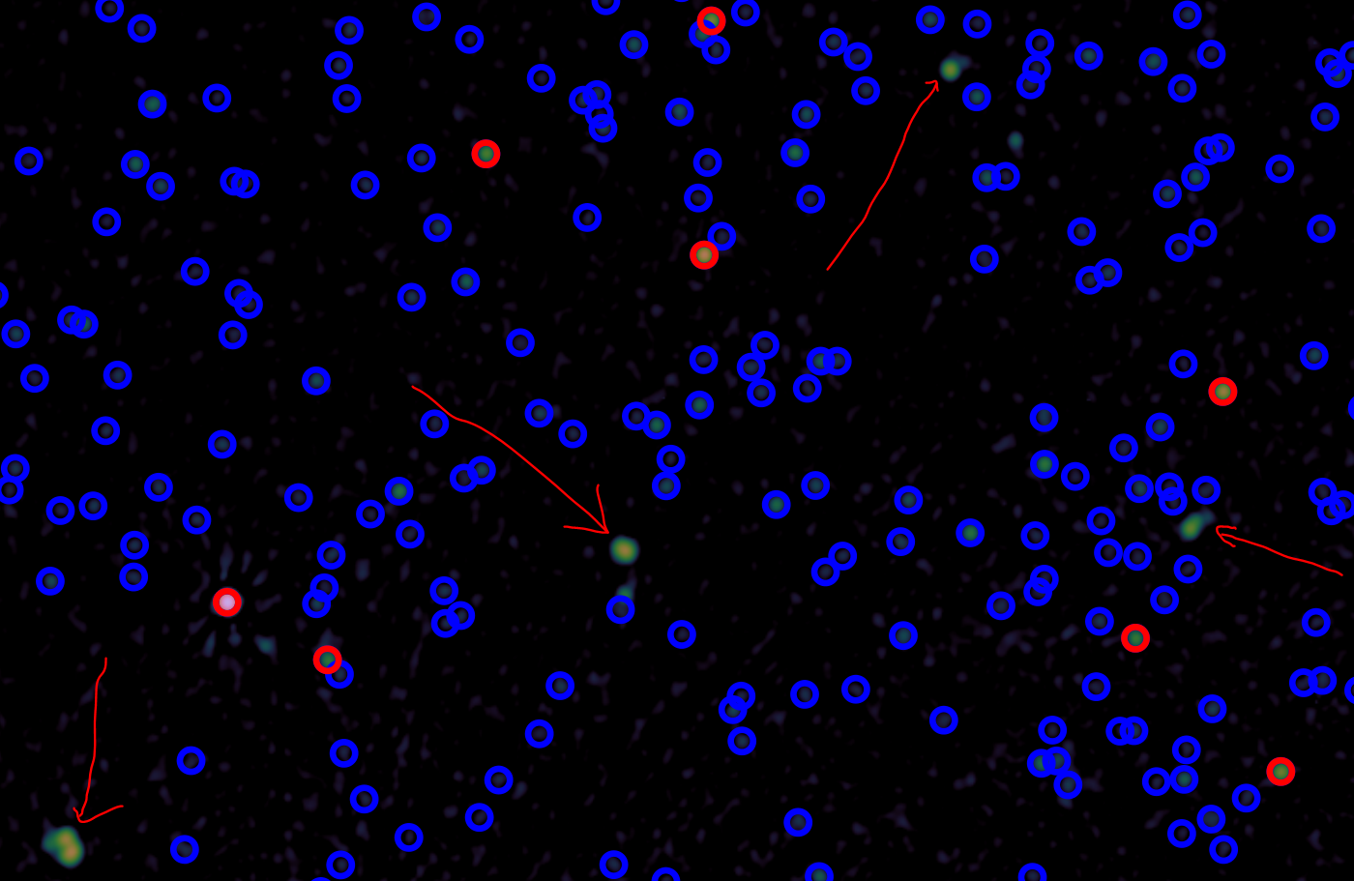
Selecting AGNs and applying photometry (3)
Some sources aren’t selected because of no obvious reason (see picture on right). It seems as if too much has been excised. Let’s look at all sources instead, not only those in the compact catalog.
This is most prabably because these sources are fitted using more than one gaussian → not classified as point source → left out of CSC
There are also many polarization sources missing!
Blue all sources > 5sigma, Red all sources >5mJy

Slide 19
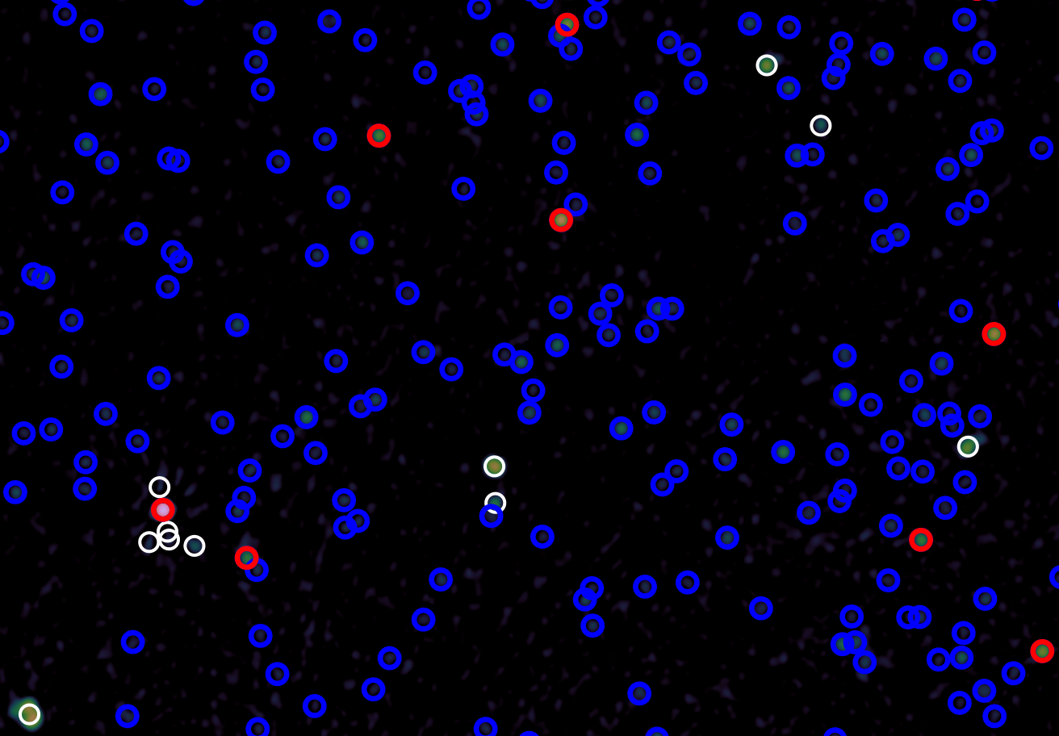
Selecting AGNs and applying photometry (4)
Let’s look at all sources instead, not only those in the compact catalog.
We see that those missing sources are present in this catalog → we need to use this one and handle with artifacts ourselves
Blue all sources > 5sigma, Red all sources >5mJy, White = filtered out from full catalog

Slide 20
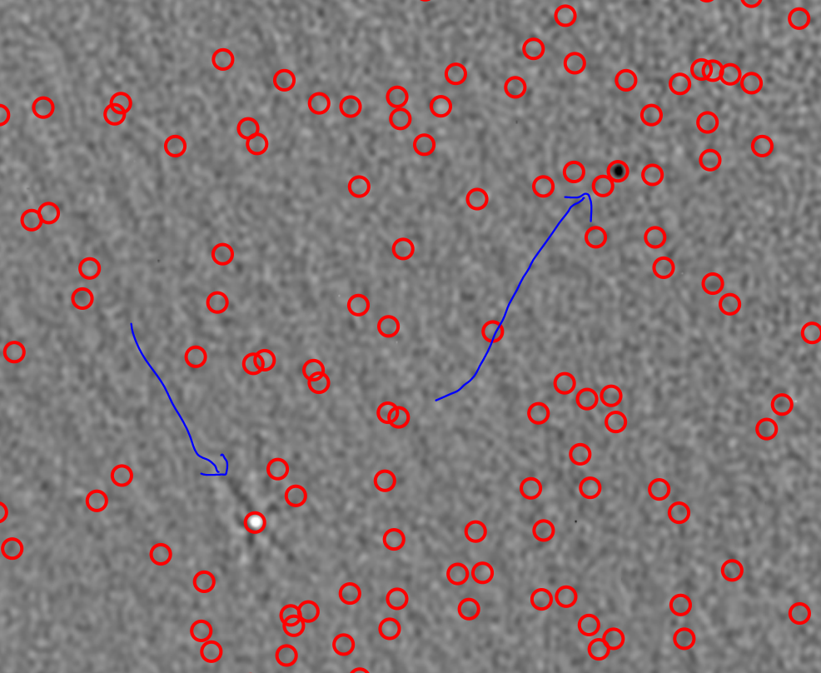
Selecting AGNs and applying photometry (5)
We also see that in the polarization plot, we see all sources are marked by the Full catalog (=pyBDSF output)
So we can use this Full catalog and check for ourselves which are sources that can be trusted
Red: all sources from full catalog

Slide 21
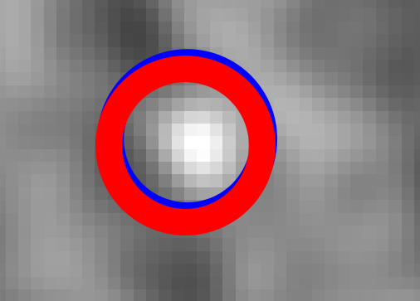
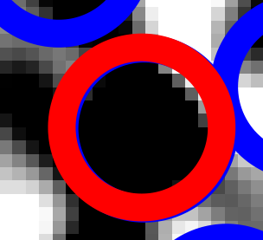
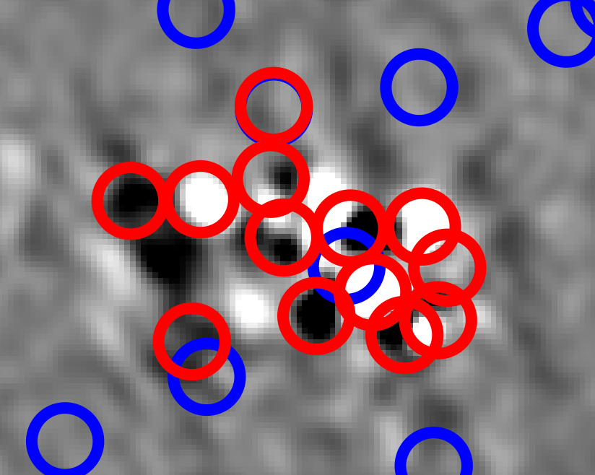
Selecting AGNs and applying photometry (6)
Which sources match Eriks sources?
In Abell 85, Erik had 18 sources. All of them were detected by Meerkat with high SNR and are present in full catalog.
Point sources match very close in position of detection (see two upper screenshots)
BUT: Where Erik selected multiple sources, the full catalog indicates multiple sources as one single source.
Blue: all sources from full catalog, Red: Erik’s selection from VLA

Slide 22
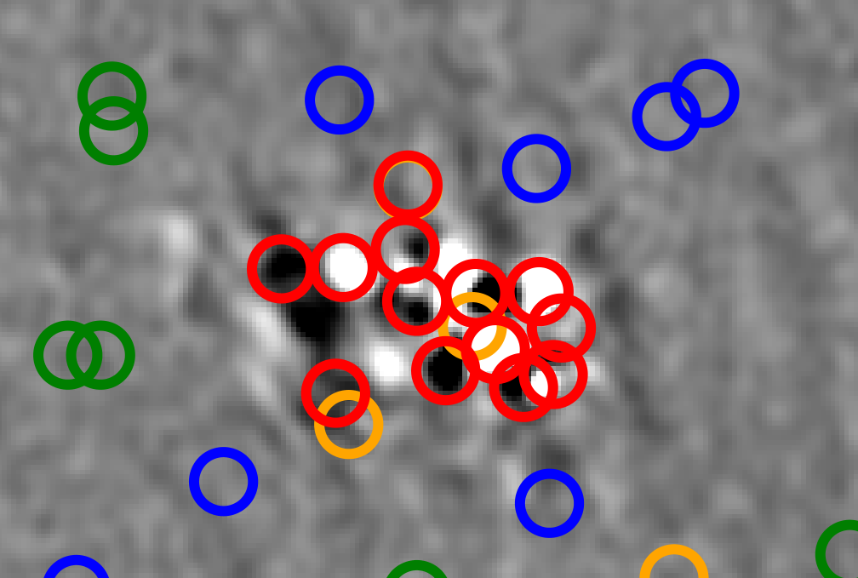
Selecting AGNs and applying photometry (7)
In the full catalog, it is indicated that it consists of multiple gaussians instead of only a single point source using the type ‘S’ for single, ‘C’ for a single gaussian part of a bigger “island”, ‘M’ for multiple gaussians.
Blue: ‘S’ sources from full catalog
Green: ‘C’ sources from full catalog
Orange: ‘M’ sources from full catalog
Red: Erik’s selection from VLA

Slide 23
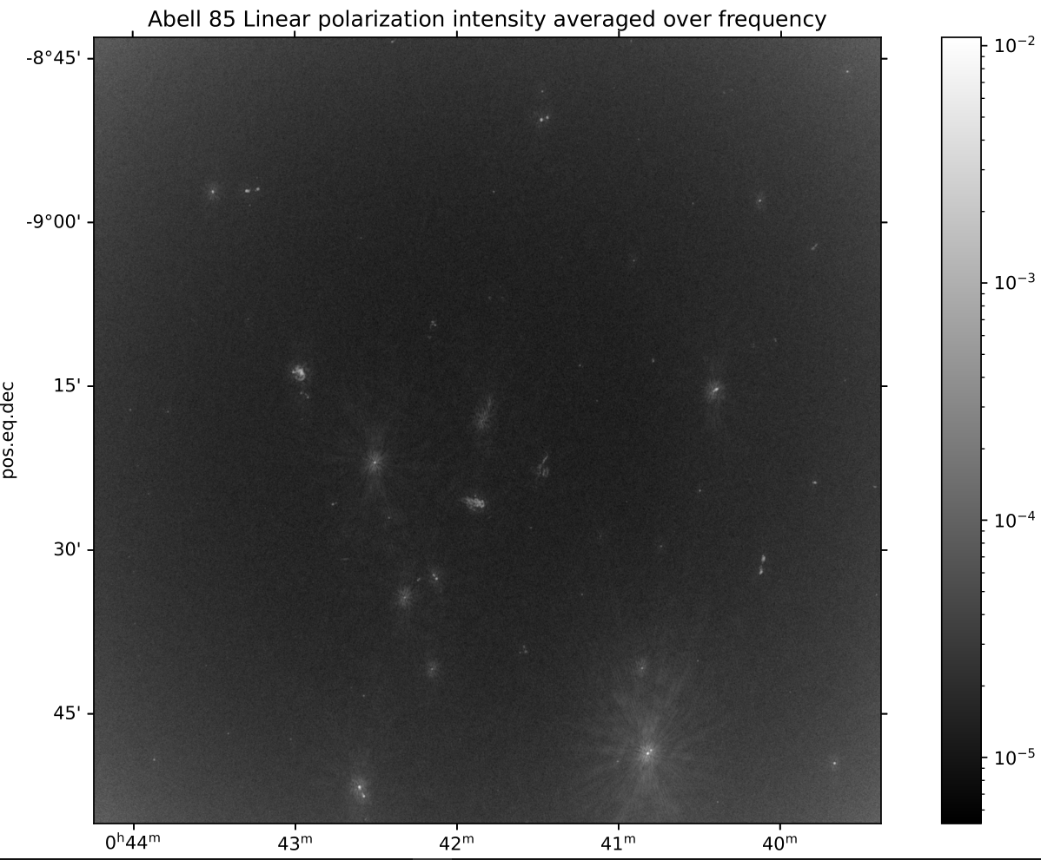
Selecting AGNs and applying photometry (8)
We will need to select ourselves in the linear polarization plot.
In order to select, we look in the beamcorrected Q and U images, perform the operation sqrt(Q^2 + U^2) and then average over all frequencies.We call this “Linear Polarization Intensity”
From that image, we select np.sqrt(12)*3*backgr_std where backgr_std is the error on the background. We take sqrt(12) because our error has become a factor sqrt(12) smaller by averaging over 12 frequency planes.
We calculate the background and its std based on sigma_clipped_stats: gives std=7.47e-06mJy
Gives a pretty image:

Slide 24
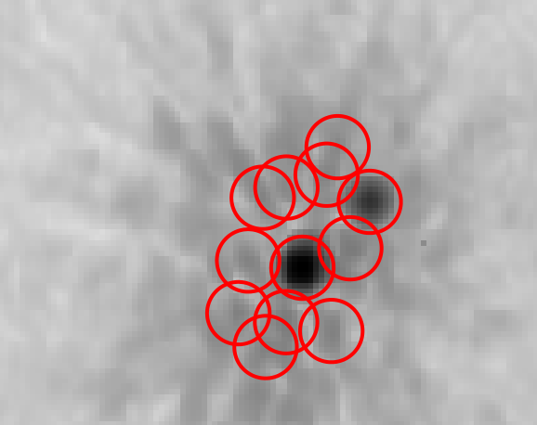
Selecting AGNs and applying photometry (9)
Now on to the selection. We find 42 sources given requirements from last slide.
Not all sources are selected which are visible in the averaged linpol image, most of them not visible in Q data cube at most frequencies. However, some sources ARE visible in the Q data cube and still not selected → this selection is a good first proof of concept and selects brightest objects
At the edges, more sources are selected when we place the requirement at 5sigma instead of sqrt(12)*3sigma. Probably due to primary beam correction → Need to be carefull with beam corrected image when searching dimmer sources, not problem now
Artifacts are also selected with our sqrt(12)*3 limit, need to remove these

Slide 25
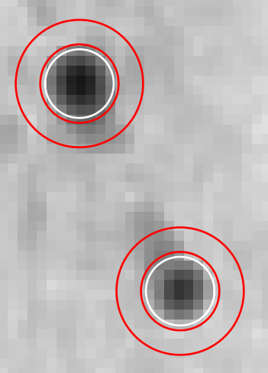
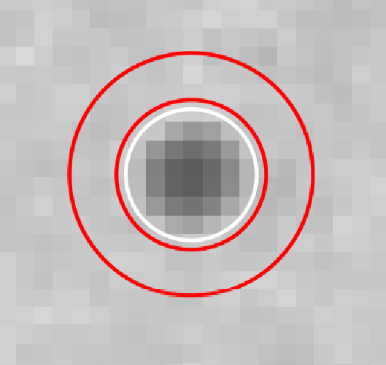
Selecting AGNs and applying photometry (10)
Applying “photometry” is done using aperture photometry as a first proof of concept. We choose aperture radius 7 pixels, annulus from 8 to 13 pixels.
We see that some sources are fluctuating strongly in Q and U, good sign!

Slide 26
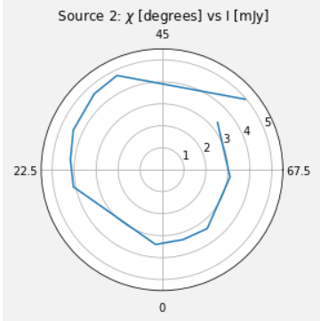
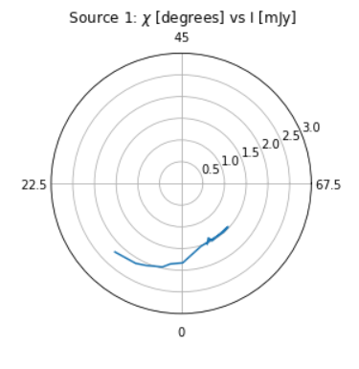
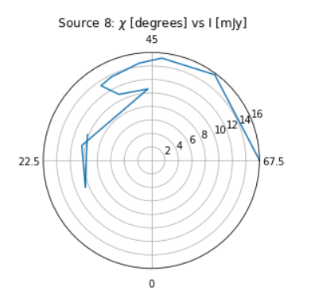
Selecting AGNs and applying photometry (11)
We plot chi=(1/2)*arctan(U/Q), the angle of polarization as function of intensity I in a polar plot, we see nice rotation for some sources, more messy rotation for others.
Low RM
Median RM but messy
High RM

Slide 27
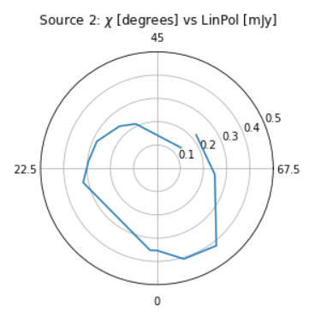
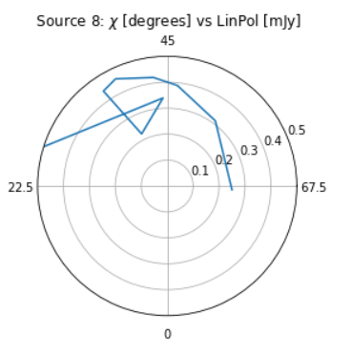
Selecting AGNs and applying photometry (12)
What about angle vs polarization intensity, do we already see a hint of depol?
No, not immediately

Slide 28
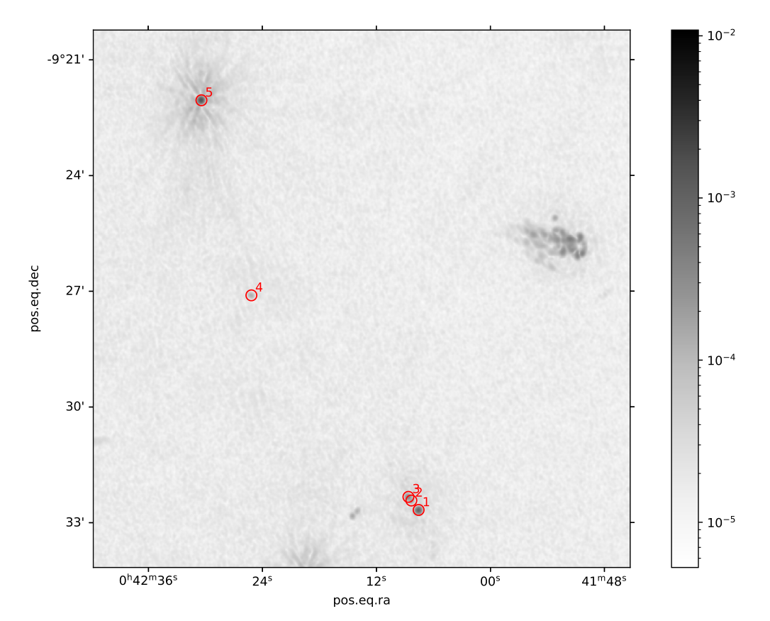
Q-U of brightest sources comparison MKT<->VLA (1)
We will look at five sources which are not too extended and appear both in the VLA and MKT data.
On the right these sources can be seen, the size of the circles matches that of the apertures we use to measure the flux.
Source 4 and 5 are the best ones, 1,2 and 3 are very close to each other.

Slide 29
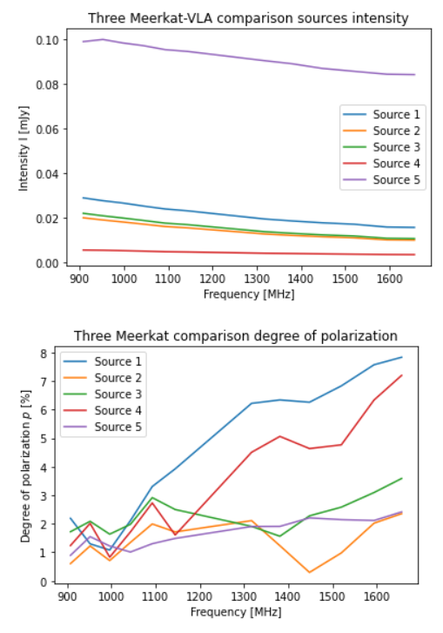
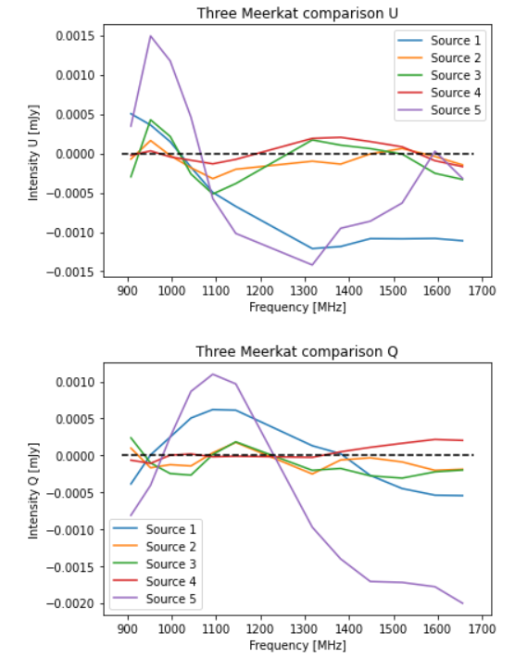
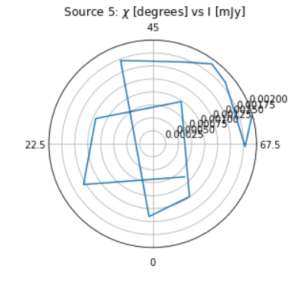
Q-U of brightest sources comparison MKT<->VLA (2)
For these five sources, we measure the I, Q and U intensity but also the polarization angle (0,5*arctan(U/Q)) and the degree of polarization (sqrt(Q^2 + U^2)/I)

Slide 30
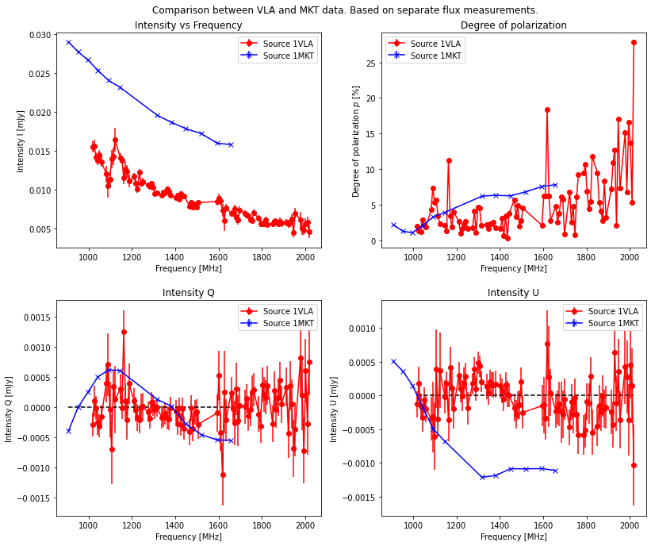
Q-U of brightest sources comparison MKT<->VLA (3)
How do our flux measurements compare to that of the VLA data by Erik?
Source 1 doesn’t match nicely in Q or U
There seems to be a systematic error in I

Slide 31
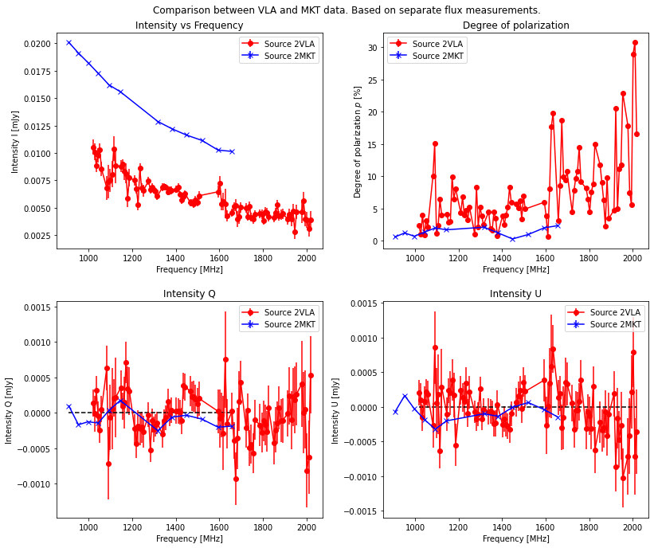
Q-U of brightest sources comparison MKT<->VLA (4)
How do our flux measurements compare to that of the VLA data by Erik?
Source 2 matches better in Q or U
There seems to be a systematic error in I

Slide 32
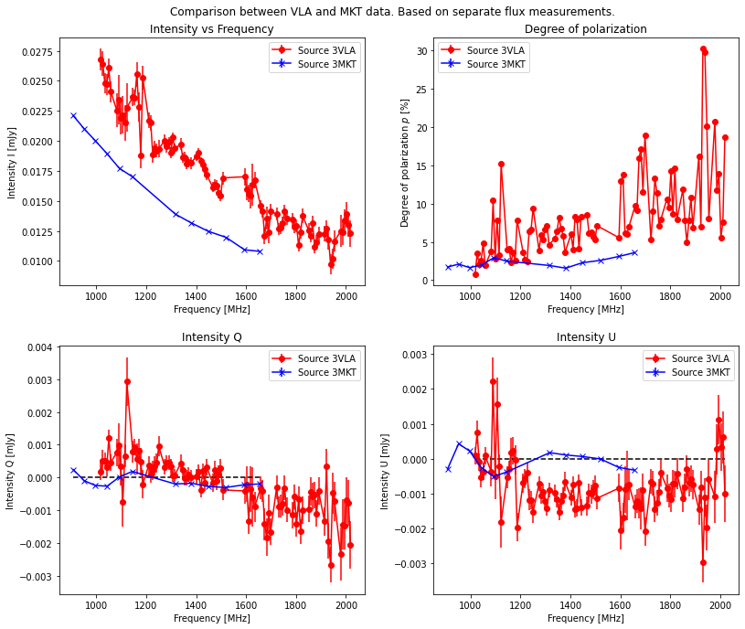
Q-U of brightest sources comparison MKT<->VLA (5)
How do our flux measurements compare to that of the VLA data by Erik?
Source 3 matches a bit in Q but not in U
There seems to be a systematic error in I

Slide 33
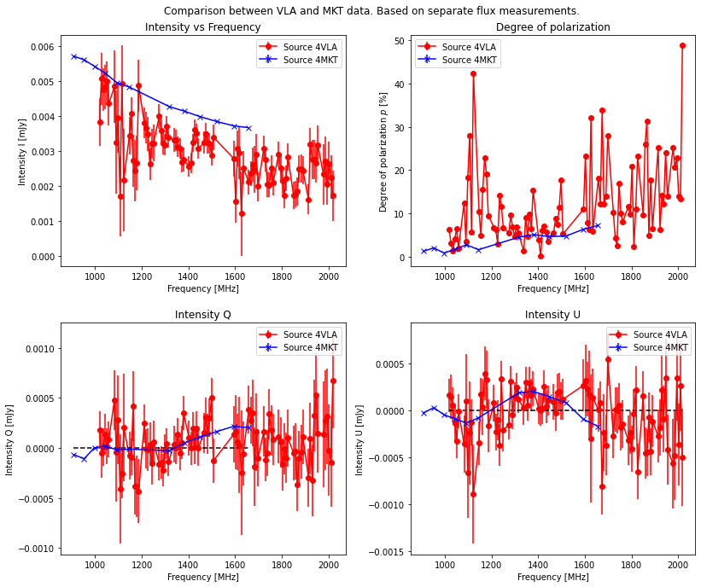
Q-U of brightest sources comparison MKT<->VLA (6)
How do our flux measurements compare to that of the VLA data by Erik?
Both Q and U match nicely
There seems to be a systematic error in I

Slide 34
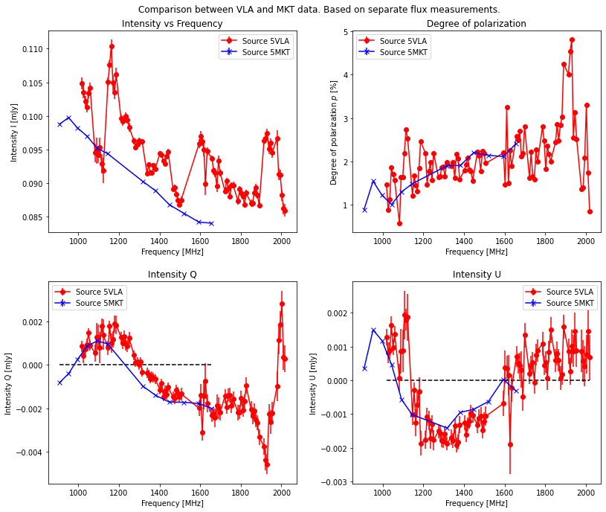
Q-U of brightest sources comparison MKT<->VLA (7)
How do our flux measurements compare to that of the VLA data by Erik?
Both Q and U match nicely, but a small systematic errors seems present
There seems to be a systematic error in I

Slide 35
Q-U of brightest sources comparison MKT<->VLA (8)
We also see a regular spike in VLA data in all sources either upward or downward in both I and U channels around 1100MHz (indicated in green). Erik says this is a known issue.

Slide 36
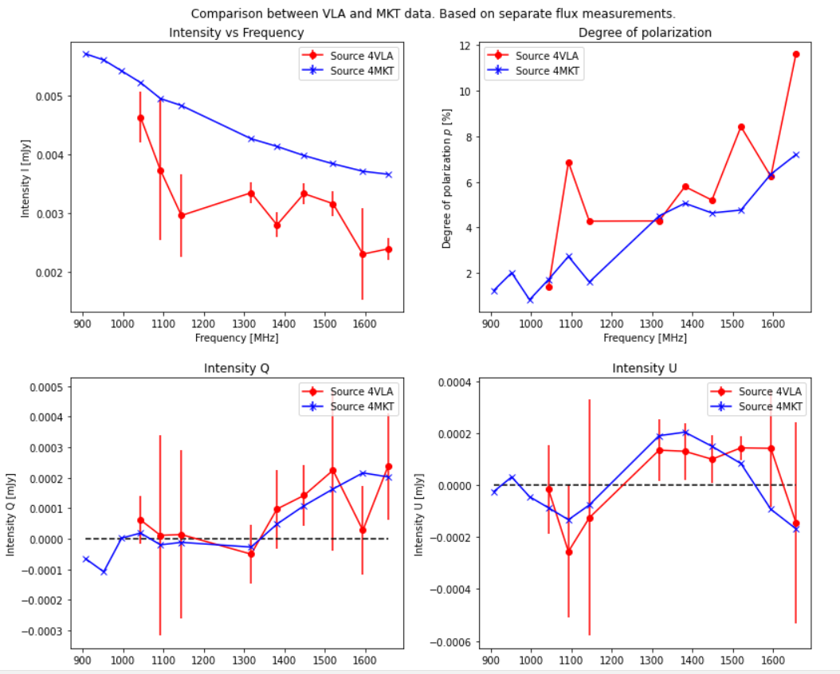
Q-U of brightest sources comparison MKT<->VLA (9)
In order to compare apples to apples, we bin the VLA flux measurements as measured by Erik in the same subbands as Meerkat. This is possible because the VLA has 90 planes while MKT only has 12, making the binning accurate enough for comparison.
The error is calculated by taking the STD of all VLA planes in each bin.
Let us focus on source 4 and 5 as these are single sources.

Slide 37
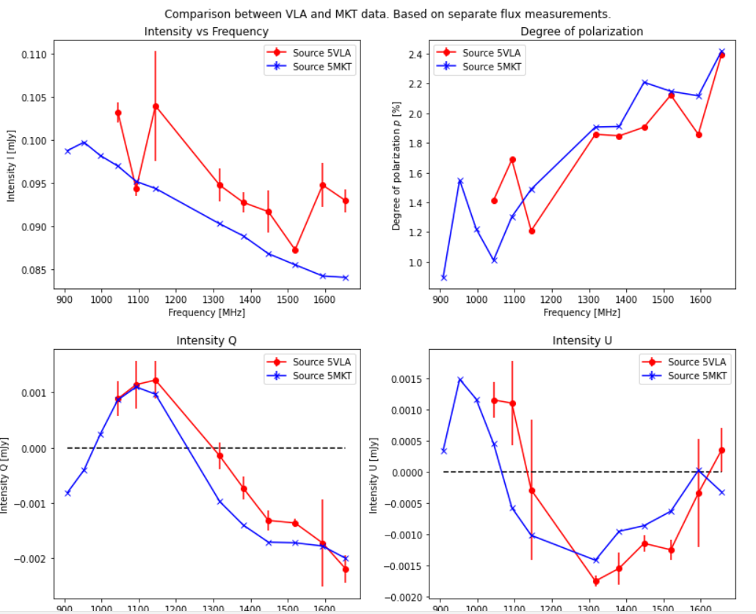
Q-U of brightest sources comparison MKT<->VLA (10)
Source 4 (previous slide) and source 5 match nicely between MKT and VLA, good news!
Also depolarization in degree of polarization plot seems to match for both. This indicates that leakage is not dominant reason for pol increase at larger freqs.

Slide 38
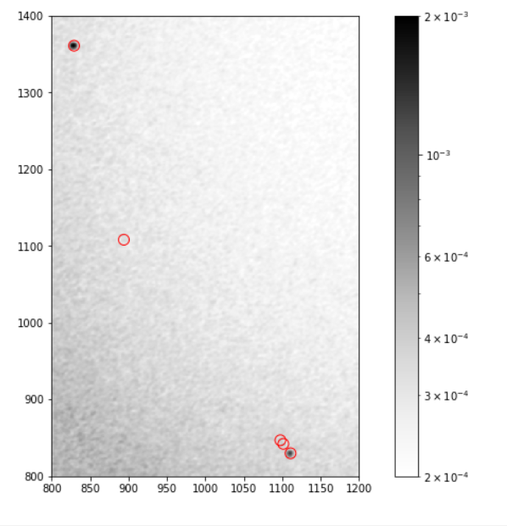
Q-U of brightest sources comparison MKT<->VLA (11)
But did I measure the same thing as Erik? Maybe he used radically different apertures causing different fluxes to be measured.
We now do flux measurements for ourselves on the same VLA (corrected by Erik) data and compare them.
On right: our apers on VLA linpol data. We see minor deviation possibly due to pointing error of telescope(s)

Slide 39
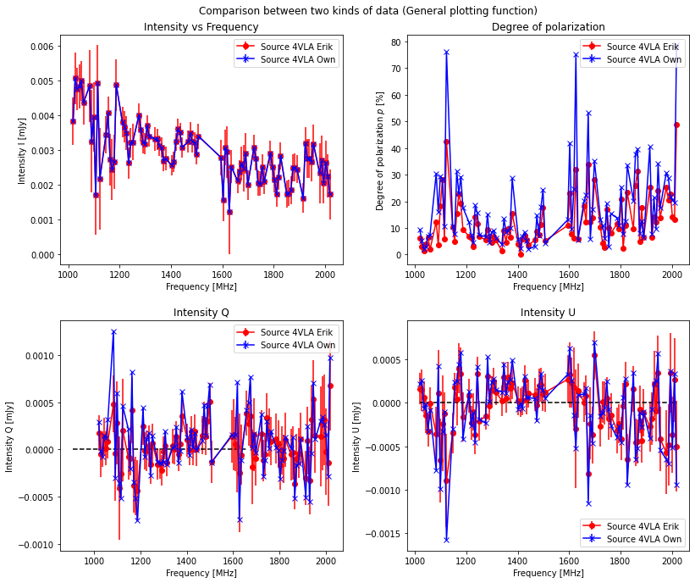
Q-U of brightest sources comparison MKT<->VLA (12)
We see that things match nicely. The upper left plot should be ignored, we didn’t measure flux from I ourselves.
This matches → means our flux measurement technique works!
On right: source 4

Slide 40
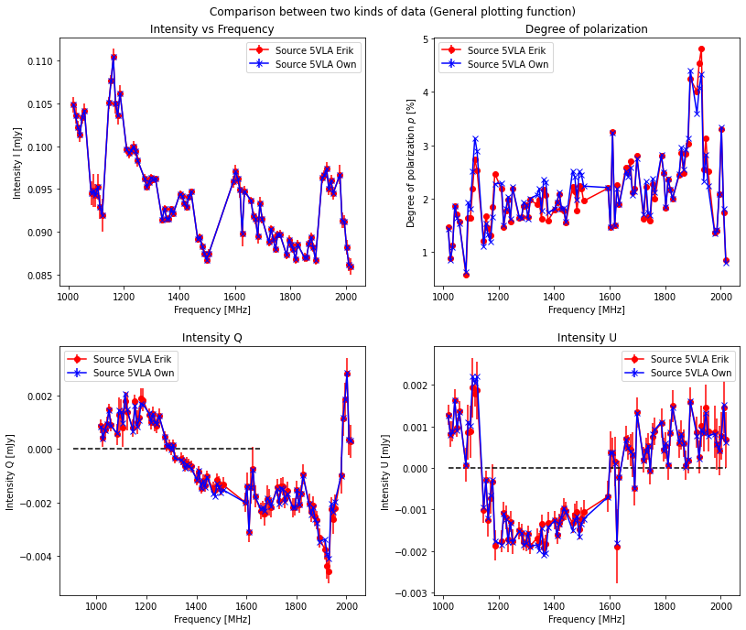
Q-U of brightest sources comparison MKT<->VLA (13)
On right: source 5
Things still match
This also means that our conclusions from comparing our flux measurements with those from Erik are valid. HOWEVER! Only for the single resolved sources 4 and 5.

Slide 41
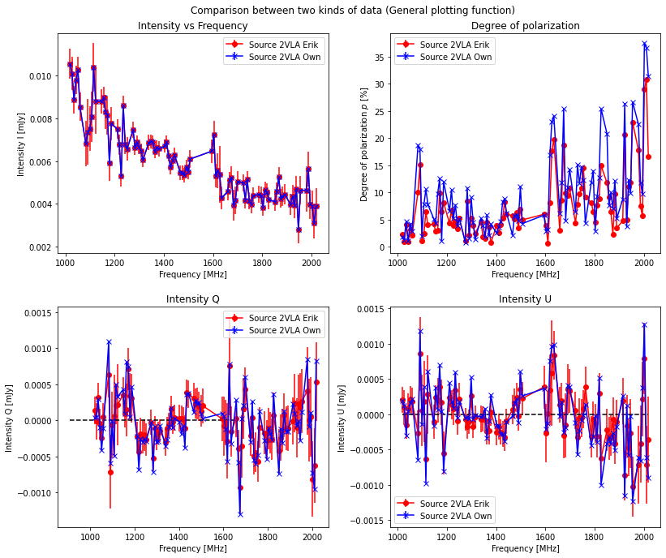
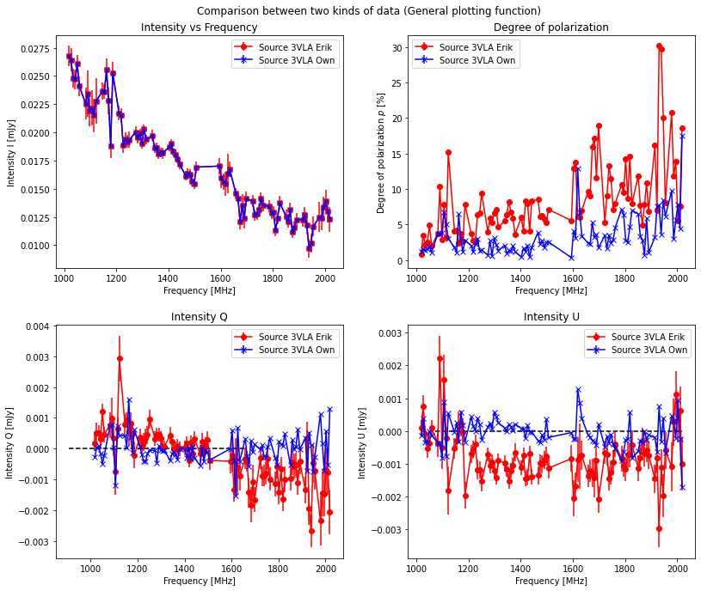
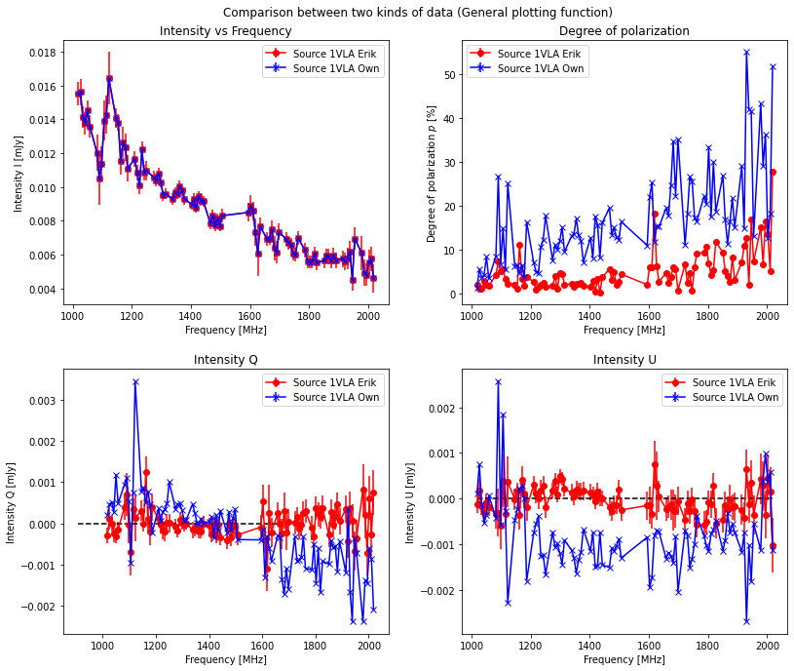
Q-U of brightest sources comparison MKT<->VLA (14)
For source 1,2,3 this matches less nicely. Mostly 1 and 3 deviate very much.

Slide 42
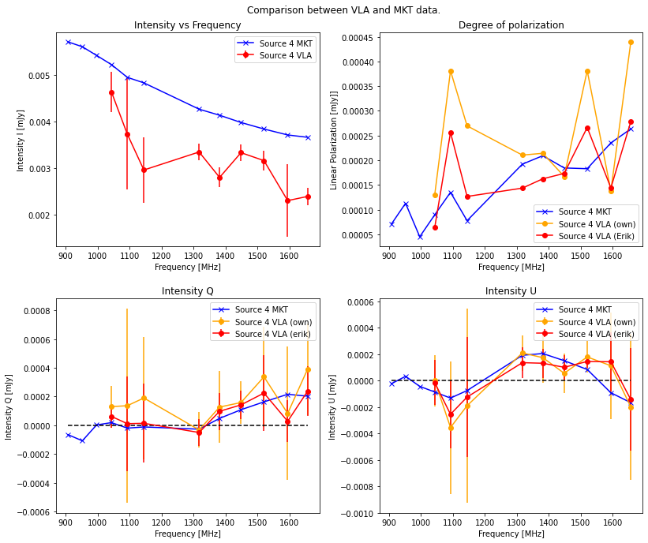
Q-U of brightest sources comparison MKT<->VLA (15)
Lets now compare all three: own MKT, Eriks VLA, Own VLA
We see that it all matches quite nicely for source 4 and 5!
Source 4 →

Slide 43
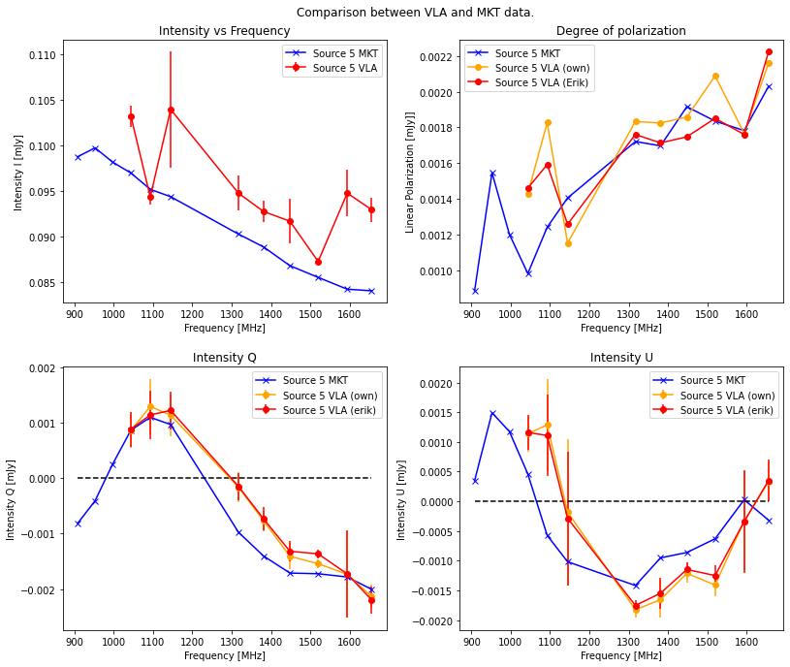
Q-U of brightest sources comparison MKT<->VLA (16)
Lets now compare all three: own MKT, Eriks VLA, Own VLA
We see that it all matches quite nicely for source 4 and 5!
Source 5 →

Slide 44



Q-U of brightest sources comparison MKT<->VLA (17)
We also see that if we use our own flux measurements, that sources 1,2 and 3 now match much more nicely
So, the discrepancy wasmostly due to the different photometry method.
Red arrows: fits nicely where Eriks fluxes don’t

Slide 45


Q-U of brightest sources comparison MKT<->VLA (17)
We also want to have an uncertainty on our flux measurements. For this, we use the same equation as Erik:
For this, we need to know the error in the background. We don’t have a uniform background due to primary beam correction, so we get this from an annulus around each source. This annulus is taken big (30 to 40 pix radius) in order to avoid inserting other sources (1,2,3) or artifacting (5) into the annulus.
For now, we assume each object is only one beam, so N=1
For delta_cal, we assume a value of 0,05

Slide 46

Selection of many sources in Abell 85 (1)
We want to look at the global picture with many sources: do we have on average 0 Q, 0 U, what are the statistical distributions.
For this, we first use photutils since BDSF can’t install on laptop, we need to run that on SSH that I don’t have working yet.
We use a circular mask to cut off beam at too large distance from the pointingcenter. We use a radius of 0,6*height of image and a limit of 3 sigma above background RMS. RMS is calculated globally and is thus on average larger than RMS in circular mask.
This results in ~180 sources, some of which are artifacting around bright sources.

Slide 47



Selection of many sources in Abell 85 (2)
What about the statistics?
We see that the Q and U distributions are nicely centered around 0. Means no large deviation due to leakage. Same story for V but is less relevant
Q
Note: all frequency bands are plotted → 12 points/source
U
V

Slide 48



Selection of many sources in Abell 85 (3)
We see that the polarizations are sort of gaussian but more “pointy”
No obvious frequency dependency of spread
Q
Lower Freq → red, high freq → blue
V
U

Slide 49

Selection of many sources in Abell 85 (6)
When plotting degree of pol vs intensity, we clearly see a distinction between noise sources (upper left) and real polarization sources (lower right). This can possibly be used to evaluate how well selection has been done.
We here start to see that for the real sources, higher freqs have higher linpols (due to depol or leakage). Noise sources don’t really show this pattern.

Slide 50

Selection of many sources in Abell 85 (7)
What about radial dependence (distance to pointing center)?
Lets first look at degree of polarization.
We see again two groups, noise sources and real sources
From colours we see frequency dependence at all radii equally strong, both close and far away → suggests this is depol because leakage should be stronger at far radii

Slide 51

Selection of many sources in Abell 85 (8)
To make this more quantitative, we plot the slope of a fit on linpol frequency dependence vs distance from pointing center. If leakage effect → should see obvious effect of increase of this slope towards edge of image

Slide 52


Selection of many sources in Abell 85 (9)
If we look at the Q and U vs radial distance from the center, we see everything is nicely centered around 0 at first glance.

Slide 53

Selection of many sources in Abell 85 (10)
But what about the distribution of polarization angles?
This is suspicious! What is going on? We see that on average, sources are more polarized at an angle of 0,2 rad than at -0,3.
No frequency dependence visible in this angle balance. But probably too little sources to tell this way.
Similar to Fig. A.4 in Eriks paper

Slide 54

Selection of many sources in Abell 85 (11)
If we change our requirements to no circular mask and 2*RMS, we get a much weaker sinusoidal shape. This means that the noise sources are not the dominant reason for this systematic effect.
And this means that the real sources of polarization probably have a strong systematic error in angle.
Low frequencies more affected than high freqs.
No circular mask, 2*RMS

Slide 55

Selection of many sources in Abell 85 (12)
If we compare with no circ mask and 2*RMS, we are looking at ~5000 sources so very dominantly noise (see right)

Slide 56



Selection of many sources in Abell 85 (13)
If we now, with 2*RMS limit and no mask, look at linpol degree vs intensity, we see that the left upper group has increased enormeously in population, as expected.
We now also see that both the noise sources AND the real sources are polarized stronger at high frequencies.

Slide 57

Selection of many sources in Abell 85 (14)
With 2*RMS and no mask:
We see that there is one large blob with lots of noise sources, these only appear around 0,7 degrees due to the primary beam correction.

Slide 58


Selection of many sources in Abell 85 (15)
And we also see that these noise sources are nicely centered around 0 Q and U.

Slide 59


Selection of many sources in Abell 85 (16)
If we select only sources with 2*RMS outside of the circular aperture, we can look at almost only noise sources.
We still see some fluctuation in angle distribution → noise sources also suffer from this bias
Almost no real sources, in total we have ~4500 sources

Slide 60




Checking Abell 133 as comparison
We use 3*RMS limit and circular aperture of radius 0,6*height frame as selection criteria of sources.
Q
U
I estimate ~200 real sources (no artifact or noise)

Slide 61


Checking Abell 133 as comparison
We use 3*RMS limit and circular aperture of radius 0,6*height frame as selection criteria of sources.
We again see no obvious increase in Linpol wavelength dependence as we go to larger separations from center
To check this more quantitatively, we plot linpol spectral slope (from linear fit) vs distance from center. We don’t see an increase at further distance → indication that we see depolarisation and not decrease of leakage at lower freqs

Slide 62

Using PyBDSF to do source detection
PyBDSF takes very long on Zuidplas → converted to python file
PyBDSF takes also very long on lofar1, same issue. Problem lies with fitting islands with gaussians. First 4800 take few minutes, last 80 take a full day to process. Why? This is probably due to my settings. BDSF really tries its best to fit guassians in islands, for example in artifacts. This is bad → I added the parameter rms_box=(30, 10). This speeds up things in order of 50 times!
Other solution is ini_gausfit='simple’, this doesn’t speed up things noticeably but changes selected regions, extended sources are fitted more poorly. Adding peak_maxsize=10 doesn’t affect speed much but also doesn’t really make a difference in the result.
Region selection based on frequency averaged image
Yellow: Fully automatic
Red: with rms_box=(30,10)
Cyan: with rms_box=(30,10) and ini_gausfit=‘simple’

Slide 63

Using PyBDSF to do source detection
If we only use parameter rms_box=(50,16) (and also trim_box=(1000,2000,1000,2000) just to do things quicker), we see that (50,16) is a better size to use than (20,6). With (20,6) less components are correctly recognized. We start to see some nontrivial detections in artifacting in (50,16). Thus, we use (30,10) as compromise.
Region selection based on frequency averaged image
Yellow: rms_box=(50,16)
Blue: rms_box=(40,13)
Red: rms_box=(30,10)
Green: rms_box=(20, 6)

Slide 64

Using PyBDSF to do source detection
The selection is not only heavily dependent on rms box size but also step size, see image on right. We stick to step = ¼-1/3 of boxsize as adviced in BDSF documentation.
Region selection based on frequency averaged image
Blue: rms_box=(50,20)
Yellow: rms_box=(50,16)
Blue: rms_box=(50,15)

Slide 65
Using PyBDSF to do source detection
When not using trim_box=(1000,2000,1000,2000), process still takes long and takes extremely long for just a few sources. We investigate where this goed wrong by splitting the image in four and inspecting one by one.
First off: (0,2000,0,2000) → takes few minutes for first 1408 islands and then 2h15min for island 1409, 1410. I then abort this run.
When looking at the islands temporary BDSF file, we see that the islands aren’t fitted from easy to hard but just scanned based on position. We thus find it very suspicious that the last sources always take long. But maybe this could be due to high RMS at edge of image?

Slide 66




Using PyBDSF to do source detection
Constructed gaussians
(0,1000,0,1000) takes few minutes, we see lots of false sources in bottom left corner
(1000,2000,0,1000) takes under a minute
(1000,2000,0,1000) takes also under a minute
(1000,2000,1000,2000) is equally fast
Problematic regions are not the cause of how long it takes, instead shear amount is probably the problem
When running the cube instead of freqmean, not significantly slower
ch0
ch0
ch0

Slide 67
Getting flux from PyBDSF regions

Slide 68
New strategy
After discussing the Linpol bdsf problems with Reinout and Erik, we decide to first do island selection using bdsf on the I map

Slide 69
Creating a custom RMS map

Slide 70
Notes
Don’t forget: planes will need to be convolved to equal resolutions
How do NANs in images influence data analysis?
Overplotten Erik components apers op die van mij
Radiale plot → delen door frequentie?
What to use as RMS? PyBDSF RMS?

